Slide 1
WORLD DEVELOPMENT INDICATORS
Shruti Ramesh Susmita Madineni Yoshita Varma

Slide 2
OVERVIEW
HYPOTHESIS:
Life expectancy is getting better for the majority of the countries across the globe. Country's development and growth can be motivating factors for increase in life expectancy.
GOALS:
Analysis of the dataset to identify if the hypothesis is supported or not? Identifying major factors and how much impact do they have in the increase of a country's life expectancy?

Slide 3
DATASET DESCRIPTION
We have used the World Development Indicators dataset to identify the factors contributing towards a country's life expectancy.
Describes data for a period of 60 years(1960-2020) for 247 countries.
Has 21 million rows with 1344 indicators.
We faced many challenges with the dataset preparation.
The dataset was not directly available, so we had to query it from the World Bank and import from wbdata.
After this, cleaning and handling the dataset also took us several days primarily because its size.
Dataset link - https://www.kaggle.com/datasets/bigquery/worldbank-wdi

Slide 4
PROJECT DEVELOPMENT
Streamlit
Streamlit has a distinctive data flow. Any time, something changes in your code or anything needs to be updated on the screen, streamlit reruns your python script entirely from top to bottom
Python libraries - numpy, pandas, plotly
This majorly helped in data cleaning and preprocessing dataset.
SQL
With SQL we were able to access data from the database.

Slide 5
LIST OF USERS
USER 1: Politicians
USER 2: The World Bank Group
USER 3: Journalists
We selected these users because they have the majorly responsible in analyzing country’s development and growth. Our complete dashboard is based on the users who have major role in knowing factors influencing life expectancy and comparing it across countries.

Slide 6
TASK DETAILS FOR POLITICIANS
Identifying their respective country in the world map visualization.
Identify if life expectancy for their country is increasing or decreasing.
Understand the correlation between world development indicators and life expectancy.

Slide 7
TASK DETAILS FOR THE WORLD BANK GROUP
Identify if life expectancies are increasing or decreasing for the countries.
Identify how the indicators are contributing for the changes in life expectancies across the countries.
In future, they can identify more development factors which are correlated to life expectancy. They can be included in this dashboard once the dataset is updated.

Slide 8
TASK DETAILS FOR JOURNALISTS
Identify and derive how the indicators are contributing to the life expectancy of the countries.
Analyze how each indicator is contributing to life expectancies increase or decrease over the years.
Analyze and compare the life expectancies across the selected countries.

Slide 9
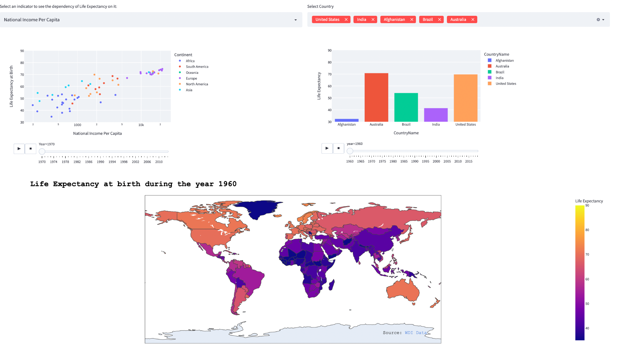
DASHBOARD DEMO

Slide 10
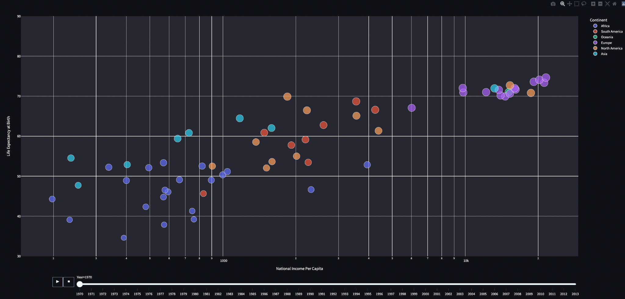
DASHBOARD VISUALIZATION - 1

Slide 11
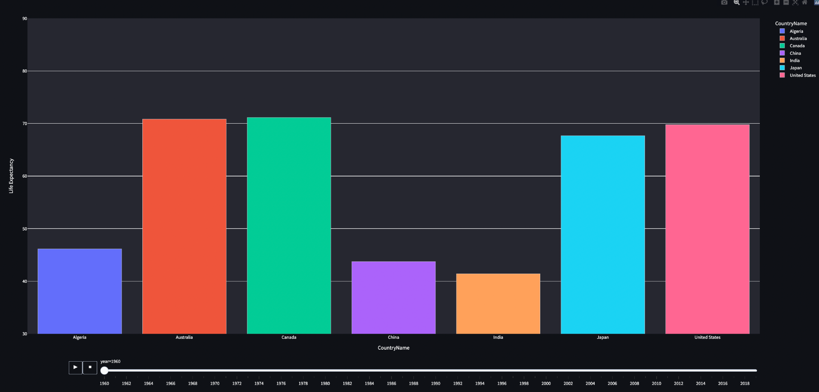
DASHBOARD VISUALIZATION - 2

Slide 12
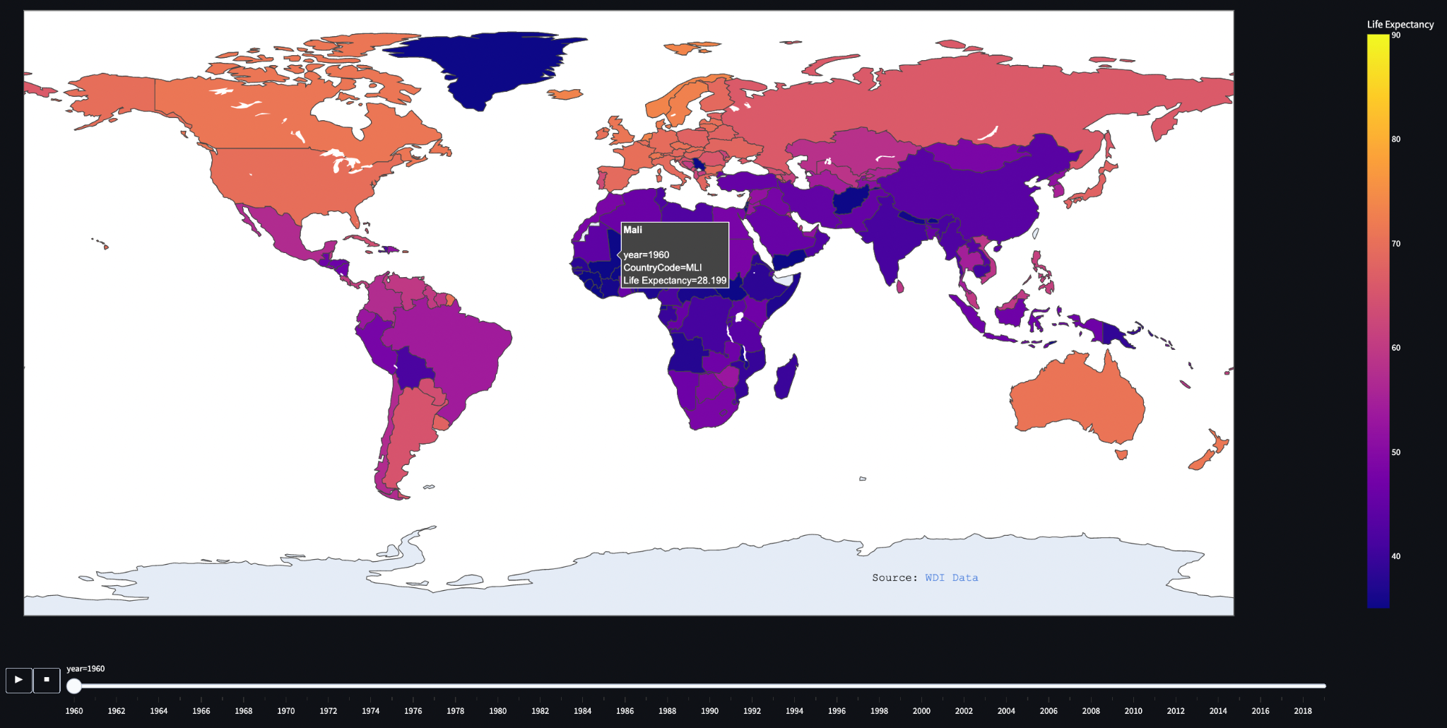
DASHBOARD VISUALIZATION - 3

Slide 13
CHALLENGES
Accessing dataset - Dataset owner hadn’t provided this data for free. So, we had to query from their database to obtain this dataset.
Dataset cleaning and preparation - As the dataset had 21 million rows with 1344 indicators with any missing values. We had to handle multiple blank chunks of data and import this information from other sources.
Animations in the dashboard - Animation goes from 1960 to 2020 for all the countries so animating such a huge dataset in each frame/second was quite challenging. We accessed sets of data frames and kept it in a loop for the set range of years to generate the animation.

